Slide 1
Reducing Cost of Fraudulent Payout
Team ESP

Slide 2
Summary
Goal: reduce cost of fraudulent events
Dataset
Features we have
Features we chose
Modeling
Classification vs regression
Model we chose
Model evaluation

Slide 3
Features we have
Quick overview
Event information, organizer, ticket prices, organizer history
What is fraud?
Training data labels undefined
All categories have money on the line
We assumed the worst
Other signals to follow
Text of event page
Organizer info (lower case names)
Organizer history

Slide 4
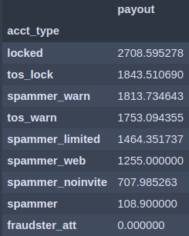
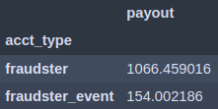
Average payout for each event
without fraud label
Average payout for each event
with fraud label

Slide 5
Features we chose
We followed the money
Ticket data (collapsed rather than unpacked)
Previous events (collapsed rather than unpacked)
Other features found via initial modeling
No dimensionality reduction
Class imbalance
Opted for as-is
Does random forest take care of that bias?
What is closest to real-world ratio?

Slide 6
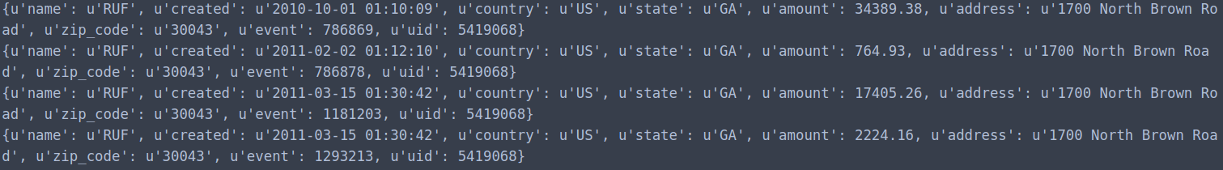
Example of ticket info for 1 event
Example of previous payout
info for 1 event

Slide 7
Models we have
Classification vs regression
CLASS: Data we have is class
REG: We care about cost of fraud, not fraud itself
REG: Prioritize potential fraud by probabilities
Cost matrix
Assumed cost of investigation = $500
Actual -> Pred | Fraud | Not
Fraud | -$500 | -$500
Not | Total Payout for event | 0
Fraud | Not
Total Payout for event | 0

Slide 8
Model we chose & evaluated
Adaboost
Assume the worst!
Can still return probabilities
Potentially work cost of fraud into model training
Gridsearch for hyperparameters
Custom cost function
Intended for training
Used for evaluating
Performance
Without model: $275,000 in potential fraudulent payout
With model: $152,000 in potential fraudulent payout

